Slide 1
OLIST STORE ANALYSIS
Brazilian E-COMMERCE Company

Slide 2
GROUP 1
AKSHATA SANAJAY PAWAR
NILESH RATHOD
SUSHMITA BADONI
ARVINDAKASAN.B
DIPAK HATUI
SUSUM NISHAD

Slide 3
OLIST STORE
Olist store is an online E-commerce platform that connects micro and small businesses to retailers and marketplaces for selling their products. Olist acts as a single point of contact between sellers and buyers. Olist was founded in year 2015 by Tiago Dalvi. The company is headquartered in Curitiba a city in Brazil.

Slide 4
OLIST OVERVIEW
Olist has put ecommerce sales datasets on Kaggle to understand business problems. The dataset has information of 100K orders from 2016 to 2018 made at multiple marketplaces in Brazil. Its features allow viewing an order from multiple dimensions : from order status, price, payment and freight performance to customer location, product attributes and finally reviews written by customers. which are cleaned and manipulated to extract valuable insights.
THE NINE CSV DATASET FILES AS FOLLOWS:-
CUSTOMER DATASET
GEOLOCATION DATASET
ORDER ITEMS DATASET
ORDER PAYMENT DATASET
ORDER REVIEWS DATASET
ORDERS DATASET
PRODUCTS DATASET
SELLERS DATASET
PRODUCT CATEGORY NAMES

Slide 5


Slide 6
DATA
TOTAL CUSTOMERS- 99441
TOTAL PRODUCTS- 32951
TOTAL SELLERS- 3095
TOTAL ORDERS-98816
TOTAL PAYMENTS- 1,60,08,872

Slide 7
KPI’S
WE WILL DIVE INTO DATA ANALYSIS AND FIND USEFUL BUSINESS INSIGHTS WHICH WILL HELP OLIST TO KEEP TRACK OF IT AND FOCUS ON CORE AREAS TO INCREASE CUSTOMER ORDERS AND SALES REVENUES FOR THE COMING YEARS.

Slide 8
KPI’S
WEEKDAYS VS WEEKENDS
ORDERS WITH REVIEW 5 AND CREDIT CARD PAYMENTS
AVERAGE DAYS OF DELIVERY FOR PETSHOP
AVERAGE PRICE AND PAYMENT VALUES OF SAO PAULO CITY
SHIPPING DAYS VS REVIEW SCORES

Slide 9
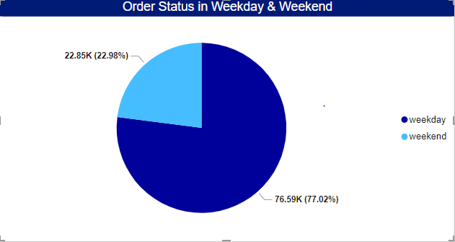
KPI-1
WEEKDAY VS WEEKEND PAYMENT STATISTICS
The analysis of payment statistics based on weekday vs. weekend provides an understanding of the buying behavior of customers. The analysis of this KPI can help Olist to improve their weekend sales and plan promotions accordingly.

Slide 10
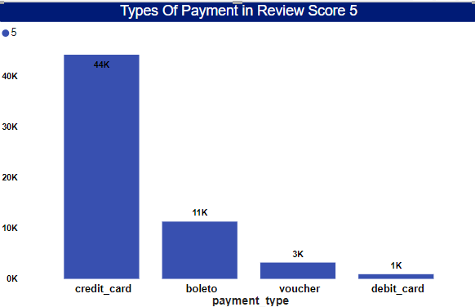
KPI - 2
NO of Orders with review score 5 and payment type as credit card.
Credit card is the highest mode of payment.
Review score 1,2,3,4 Debit card payments are almost negligible.
Olist can use this information to identify satisfied customers and encourage them to make repeat purchases BY Introducing offers and schemes on debit card payment.

Slide 11
KPI-3
Average number of days taken for order_delivered_date for pet_shop
THE AVERAGE NUMBER OF DAYS TAKEN TO DELIVER FOR PET SHOP IS 11.
OLIST CAN IMPROVE THE DELIVERY TIMING TO KEEP PET SHOP ORDERS HEALTHY.

Slide 12
KPI- 4
Average price and payment values from customers of Sao Paulo city
SAO PAULO CITY IS RANKING HIGH IN SALES
WORK IN UNDERSTANDING THE SPENDING PATTERNS OF CUSTOMERS IN THIS REGION
WORK IN IDENTIFYING HIGH- VALUE CUSTOMERS
CREATE TRAGETED MARKETING CAMPAIGNS

Slide 13
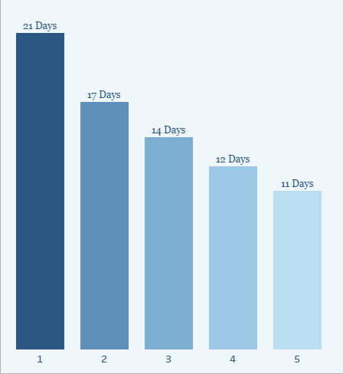
KPI-5
Relationship between shipping days VS review scores.
HIGH REVIEWS ARE OBTAINED IN LESS DAYS
THE DELIVERY DAYS CAN BE CONCENTRATED FOR MORE SATISFIED CUSTOMERS
OPTIMIZE THE LOGISTICS TO IMOROVE THE DELIVERY TIME

Slide 14
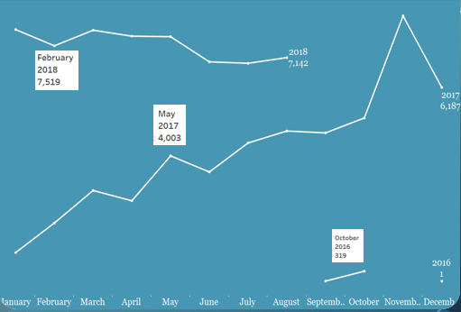
YEAR WISE ORDERS
HIGHEST YEAR OF ORDERS -2018
HIGHEST MONTH OF ORDERS-NOVEMBER

Slide 15
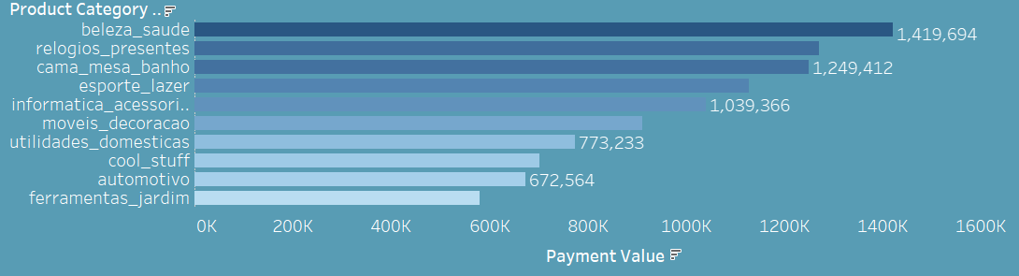
TOP 10 PRODUCTS
Beleza Saude leading with 1,419K sales.

Slide 16
CONCLUSION
The Olist Store Analysis project provides valuable insights into customer behavior and payment statistics. The analysis of these KPIs helps Olist in identifying areas of improvement and creating targeted marketing campaigns. As a data analyst, I have used Excel and Power BI to clean and manipulate the dataset and create meaningful visualizations. This project serves as a great example of how data analysis can help businesses make informed decisions.

Slide 17


